Slide 1
Graphs
Eng. Muhammad AbdulKarlim

Slide 2
Table of contents
01
02
03
04
Introduction to Graphs
Graph Terminology
What is a Graph?
Why Study Graphs?
Neighbors, Degree, Path, Cycle, Connectivity
Graph Representation
Graph Traversal Algorithms
Adjacency List
Adjacency Matrix
Depth-First Search (DFS)
Breadth-First Search (BFS)

Slide 3
Table of contents
05
06
07
08
Advanced Graph Concepts
Single Shortest Path Algos
Topological Sort
Strongly Connected Components (SCC)
Dijkstra's Algorithm
Bellman-Ford Algorithm
Johnson's Algorithm
Flow Networks
All Pairs Shortest Path
Flow Networks
Minimum Cut
Slow All Pairs Shortest Path
Fast All Pairs Shortest Path

Slide 4

01
Introduction to Graphs

Slide 5
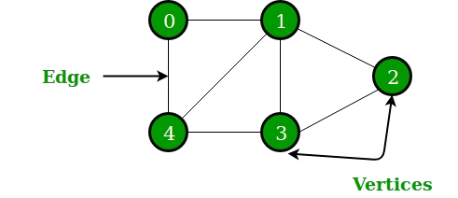
What is a Graph?
Definition
A graph is a network that helps define and visualize relationships between various components.
Components:
Nodes (Vertices)
Edges

Slide 6
Why Study Graphs?
Applications:
Graphs show up everywhere, either directly or indirectly.
Graph theory can solve modern problems.
Examples:
Social networks (LinkedIn).
Shortest path problems (e.g., navigation).

Slide 7

Examples:
Social networks (LinkedIn)

Slide 8
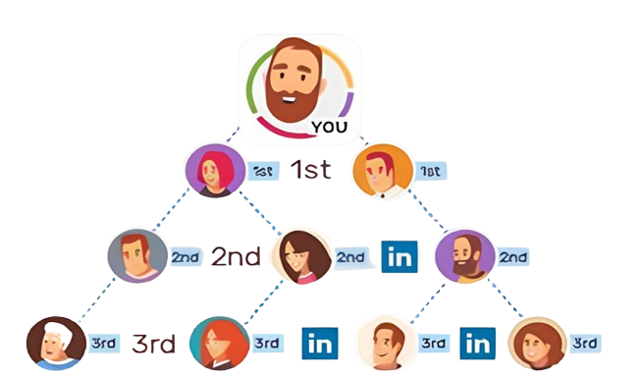
Examples:
Social networks (LinkedIn)

Slide 9
02
Graph Terminology

Slide 10
Graph Terminology
Node
Neighbors
B
Edge
Path
Weighted
10
A
D
E
Undirected
C
Directed

Slide 11

Graph Terminology
Neighbors
Path
Connectivity
Nodes connected by an edge
Sequence of vertices connected by edges
Nodes are connected if there is a path between them
Connected Components
Degree
Cycle
Number of neighbors a node has
Path that starts and ends at the same node
Subsets of nodes that are connected

Slide 12
Graphs Types
Graphs
Graphs
Undirected Graph
Directed Graph
Unweighted Graph
Weighted Graph
Cyclic
Acyclic

Slide 13
03
Graph Representation

Slide 14
Graph Representation Techniques
Adjacency List
Adjacency Matrix
An adjacency list represents a graph as a collection of lists.
Each list corresponds to a node and contains the nodes it is connected to.
An adjacency matrix uses a 2D array to represent a graph, with rows and columns corresponding to nodes.

Slide 15
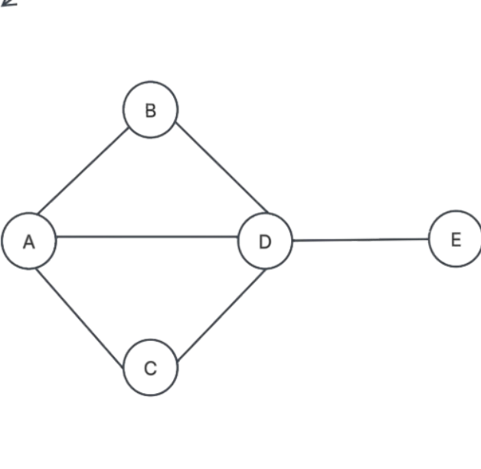
Graph Representation Techniques
Adjacency List
Adjacency Matrix
A → B, C, D
B → A, D
C → A, D
D → A, B, C, E
E → D
 | A | B | C | D | E
A | 0 | 1 | 1 | 1 | 0
B | 1 | 0 | 0 | 1 | 0
C | 1 | 0 | 0 | 1 | 0
D | 1 | 1 | 1 | 0 | 1
E | 0 | 0 | 0 | 1 | 0

Slide 16
04
Graph Traversal Algorithms

Slide 17
Depth-First Search (DFS)
DFS starts from a specific node, processing all children randomly, and ensures that each child is fully processed before moving to another. The traversal order can vary based on the structure of the graph, showcasing how deeply it explores each branch.

Slide 18
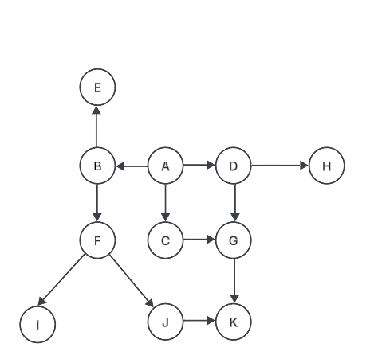
DFS Example
Traversal order: A B F I J K E C G D H

Slide 19
Topological Sort Overview
Create a sequence of nodes where each node comes before its children.
Perform DFS, and when a node is done, place it at the back (as if you push in a stack).

Slide 20
Topological Sort Overview
Sorted order:
A D H C G B E F J K I

Slide 21
Breadth-First Search (BFS)
BFS traverses all the children of a node before moving on to their children, using a queue data structure.
This method is particularly useful for finding the shortest path in an unweighted graph, allowing for systematic exploration.

Slide 22
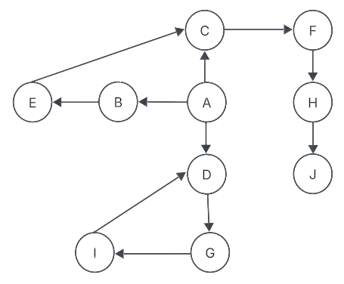
BFS Example
Traversal order: A B C D E F G H I J

Slide 23
BFS Vs DFS

Slide 24
05
Advanced Graph Concepts

Slide 25
Connectivity Concepts
Two nodes are connected if there is a path between them.
A graph is connected when all nodes are interconnected.
Connected components are subsets of nodes that are connected.

Slide 26
Strongly Connected Component (SCC)
A subgraph where every node is reachable from every other node.
It is important for analyzing networks and flow structures.
Used in applications like social networks and circuit design.

Slide 27
Types of Edges in DFS
01
02
03
04
Tree edge
Cross edge
Forward edge
Backward edge
An edge present in the DFS tree
Connects a node to a descendant
Connects to an ancestor, forming a cycle
Connects nodes in the DFS tree without ancestor/descendant relationship

Slide 28
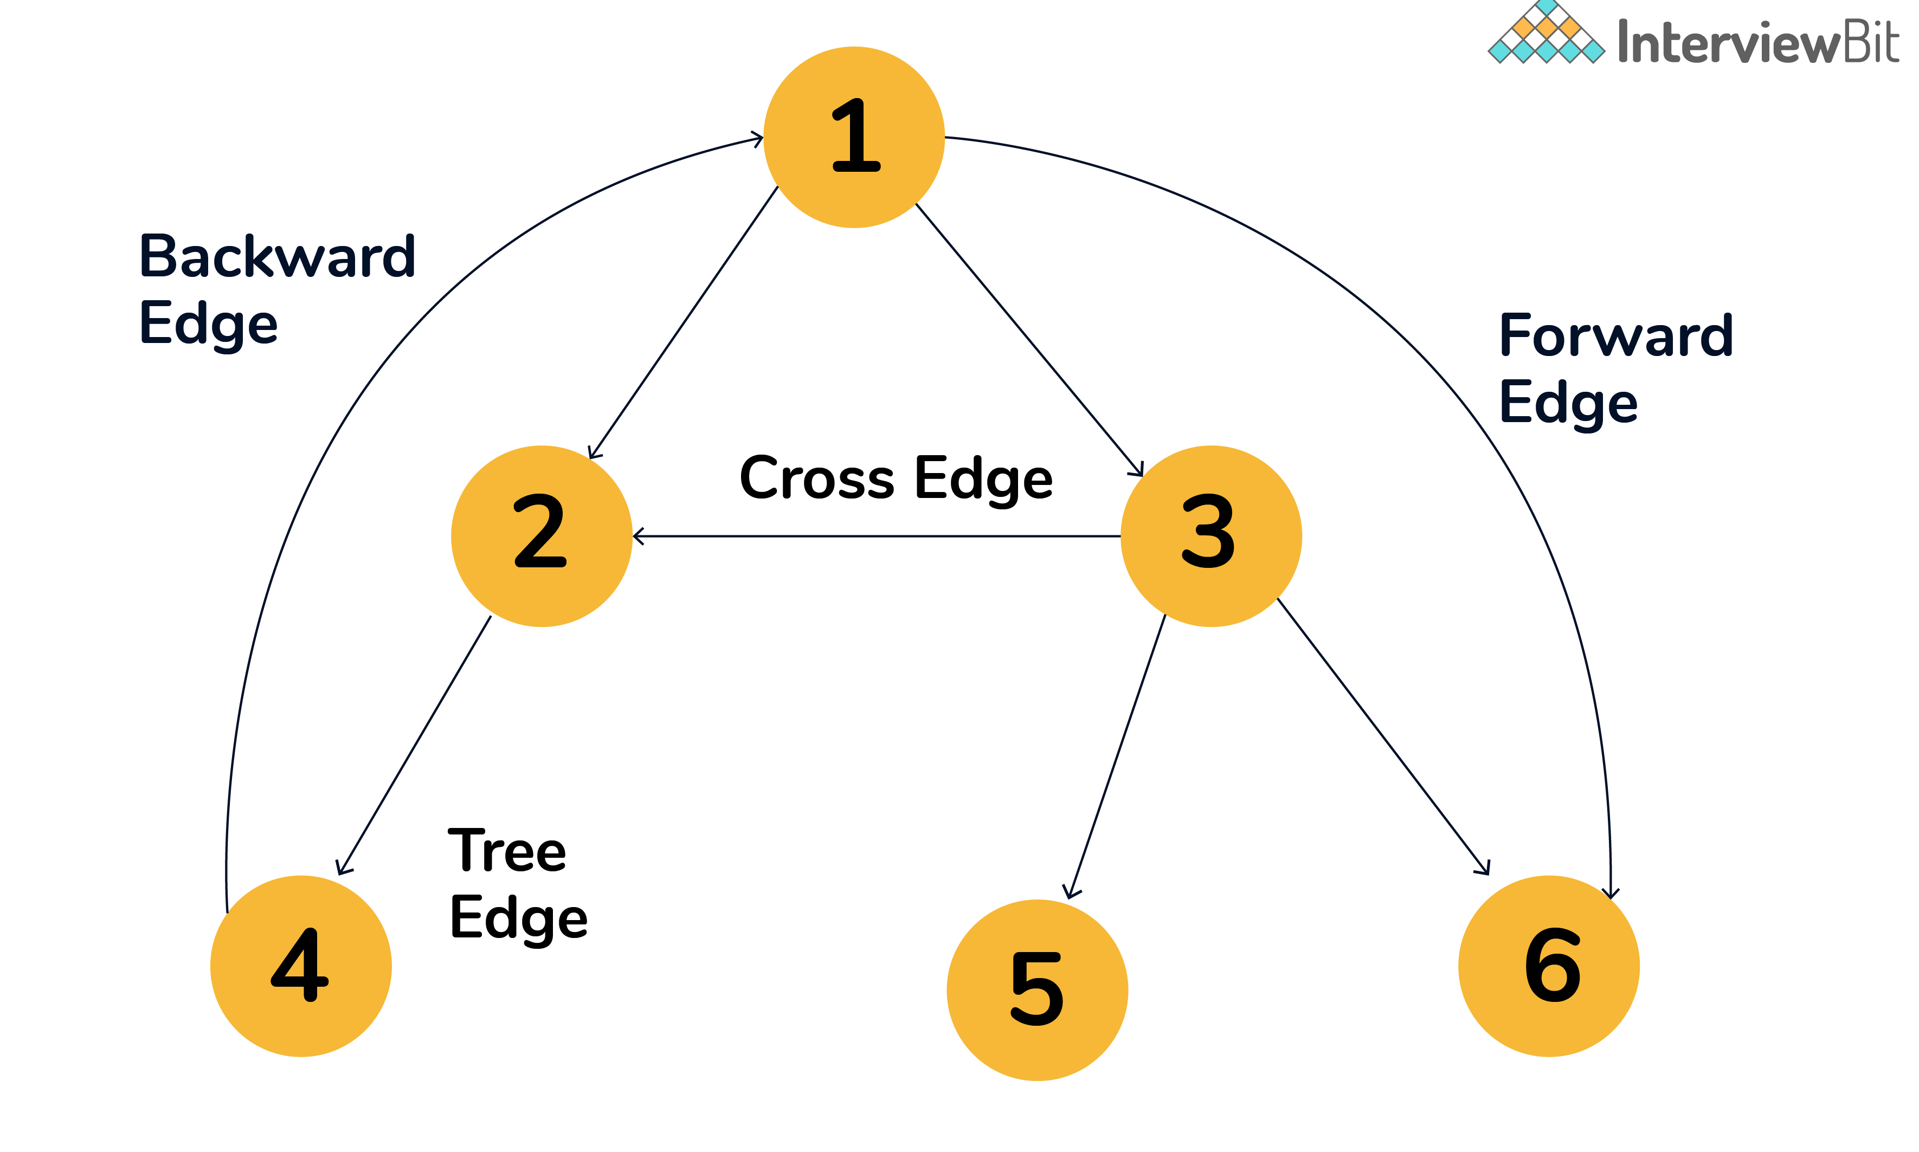
Types of Edges in DFS

Slide 29
Example
Find the Strongly connected component
q
s
t
r
v
w
y
u
x
z

Slide 30
Example
1/
16
q
T
B
8/
15
2/
7
20
s
17/
F
t
r
3/
v
w
6
4/
y
u
5
x
C
12
9/
13/
18/
19
14
B
10/
11
z

Slide 31
Strongly Connected Component
Run DFS on the reversed graph in decreasing order of completion time
Run DFS on the original graph
Reverse the edges
First
Next
Next
Last
Create trees by running DFS

Slide 32
Strongly connected component
{ r }
{ u }
{ q, y, t }
{ x, z }
{ s, w, v }
16
1/
q
T
B
8/
15
2/
20
7
17/
s
t
F
r
3/
6
v
w
4/
y
u
5
x
C
12
9/
13/
18/
19
14
B
10/
11
z

Slide 33
06
Shortest Path Algorithms

Slide 34
Single Source Shortest Path algorithms:
01
BFS
for unweighted graph
02
Dijkstra
for positive weighted graph
03
Bellman-Ford
for positive and negative weighted graph
04
Directed Acyclic graph algorithm

Slide 35
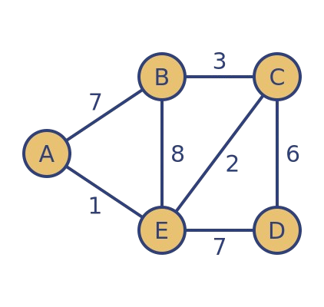
Dijkstra’s Algorithm
Dijkstra's algorithm finds the shortest path from a specific node to all other nodes.
It updates distances to neighboring nodes as it traverses the graph, ensuring that the shortest possible path is always chosen.

Slide 36
Dijkstra’s Example
∞
∞
4
B
D
5
3
0
A
1
2
6
F
∞
2
1
C
E
∞
7
∞

Slide 37
Dijkstra’s Example
Node | Distance | Parent
A | 0 | -
B | ∞ | A
C | ∞ | A
D | ∞
E | ∞
F | ∞
∞
∞
4
B
D
5
3
0
A
1
2
6
F
∞
2
1
C
E
∞
7
∞

Slide 38
Dijkstra’s Example
Node | Distance | Parent
A | 0 | -
B
C
D | ∞
E | ∞
F | ∞
5
∞
∞
4
B
D
5
3
∞
A
5
∞
A
0
A
1
2
6
F
∞
2
2
1
C
E
∞
7
∞
2

Slide 39
Dijkstra’s Example
Node | Distance | Parent
A | 0 | -
B
C
D | ∞
E
F | ∞
5
∞
4
B
D
5
3
5
A
2
A
0
A
1
2
6
F
∞
2
1
∞
C
9
C
E
7
∞
2
9

Slide 40
Dijkstra’s Example
Node | Distance | Parent
A | 0 | -
B
C
D
E
F | ∞
5
9
∞
4
B
D
5
3
5
A
2
A
0
A
1
2
6
F
∞
∞
B
9
2
1
C
7
B
9
C
E
7
2
9
7

Slide 41
Dijkstra’s Example
Node | Distance | Parent
A | 0 | -
B
C
D
E
F
5
9
4
B
D
5
3
5
A
∞
2
A
0
A
1
2
6
F
8
9
B
2
1
7
B
C
E
7
∞
8
E
2
7
Visited list in order:
A C B E F D

Slide 42
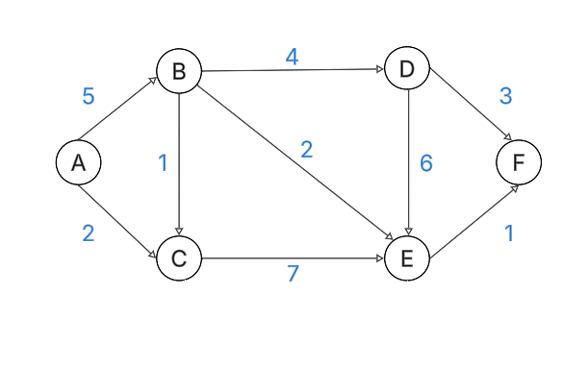
Dijkstra’s Example
Node | Distance |  |  |  | Parent
A | 0 |  |  |  | -
B | ∞ |  | 0+5=5 |  | A
C | ∞ |  | 0+2=2 |  | A
D | ∞ |  | 5+4=9 |  | B
E | ∞ | 2+7=9 |  | 5+2=7 | C B
F | ∞ |  | 7+1=8 |  | E
Visited list in order:
A C B E F D

Slide 43
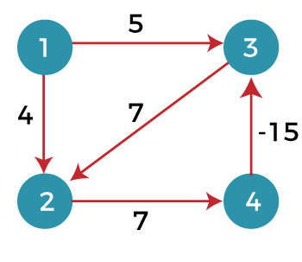
Bellman-Ford
The Bellman-Ford algorithm works on graphs with weighted edges and can handle negative weights, provided no negative weight cycles exist.
It iteratively relaxes the edges, updating the shortest path estimates until convergence.

Slide 44
Bellman-Ford’s Example
5
t
-2
x
6
-4
-3
s
8
7
7
2
y
z
9

Slide 45
Bellman-Ford’s Example
5
Iteration : 1
∞
t
-2
x
∞
7
6
-4
-3
2
∞
s
8
7
7
2
y
z
∞
0
9

Slide 46
Bellman-Ford’s Example
5
Iteration : 2
5
-2
∞
8
t
x
7
6
6
-4
-3
2
s
7
8
7
2
y
z
0
∞
9
9

Slide 47
Bellman-Ford’s Example
5
Iteration : 3
4
-2
5
t
x
6
6
-4
-3
2
s
7
8
7
2
y
z
0
9
9

Slide 48
Bellman-Ford’s Example
5
Iteration : 4
4
t
-2
x
6
6
-4
-3
2
s
7
8
7
2
y
z
0
9
9

Slide 49
Johnson's Algorithm
(Dijkstra + Bellman Ford)
1.
Adds an external node to connect all other nodes with zero-weighted edges.
Uses Bellman-Ford to establish distances from the external node.
Applies Dijkstra's algorithm for each node to derive the shortest paths.
2.
3.

Slide 50
Johnson's Algorithm’s Example
5
t
-2
x
6
-4
-3
s
8
7
7
2
y
z
9

Slide 51
Adds an external node to connect all other nodes with zero-weighted edges.
0
5
∞
∞
0
t
-2
x
6
-4
-3
∞
ε
0
s
8
7
7
2
0
y
z
∞
∞
9
0

Slide 52
2. Uses Bellman-Ford to establish distances from the external node.
0
5
-5
-3
0
t
-2
x
6
-4
-3
h=[s,t,x,y,z]
h=[-7,-5,-3,0,9]
-7
ε
0
s
8
7
7
2
0
y
z
-9
0
9
0

Slide 53
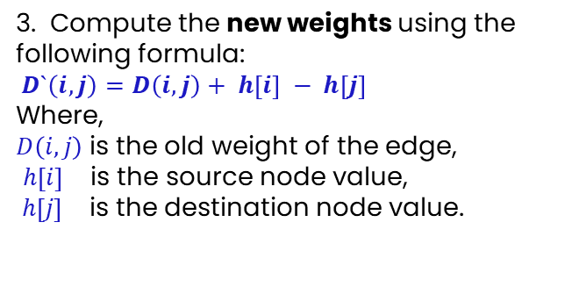
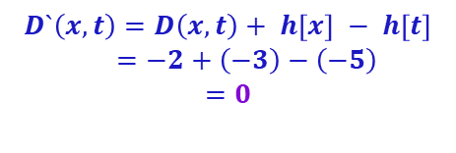
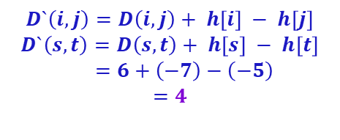
3. Compute the new weights using the following formula:
$D`\left(i,j\right)=D\left(i,j\right)+ h\left[i\right] − h\left[j\right]$
Where,
$D\left(i,j\right)$is the old weight of the edge,
$h\left[i\right]$ is the source node value,
$h\left[j\right]$ is the destination node value.
3
5
-5
-3
-2
t
0
x
4
h=[s,t,x,y,z]
h=[-7,-5,-3,0,9]
6
0
0
-3
-4
-7
$$D`\left(i,j\right)=D\left(i,j\right)+ h\left[i\right] − h\left[j\right]$$
$$D`\left(s,t\right)=D\left(s,t\right)+ h\left[s\right] − h\left[t\right]$$
$$=6+\left(−7\right)−\left(−5\right)$$
$$=4$$
s
3
8
7
0
0
2
7
$$D`\left(x,t\right)=D\left(x,t\right)+ h\left[x\right] − h\left[t\right]$$
$$=−2+\left(−3\right)−\left(−5\right)$$
$$=0$$
y
z
18
0
9
-9

Slide 54
4. Now, all the edges are transformed to positive edges, run Dijkstra to find the shortest path, start from any node.
3
-5
-3
Node | Distance | Parent
z | 0 | -
s | ∞ 0 | z
t | ∞ 4 0 | x
x | ∞ 7 0 | y
y | ∞ 0 | s
t
0
x
4
0
0
-7
s
3
7
0
0
y
z
0
18
-9

Slide 55
5. After Dijkstra, shortest paths from Z are 0 for all nodes. Transform computed distances to original distances.
3
∞
∞
Node | Distance | Parent
z | 0 | -
s | ∞ 0 | z
t | ∞ 4 0 | x
x | ∞ 7 0 | y
y | ∞ 0 | s
t
0
x
4
0
0
∞
s
3
7
0
0
y
z
18
∞
0

Slide 56
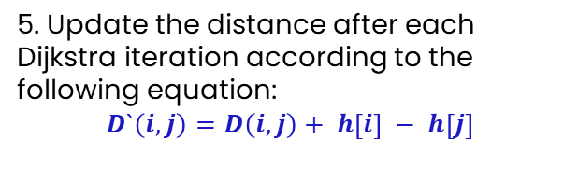
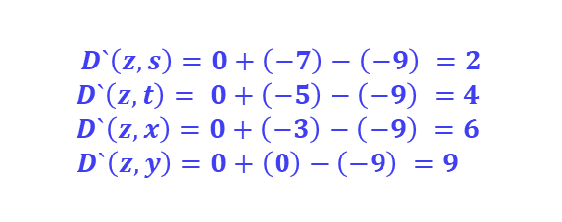
5. Update the distance after each Dijkstra iteration according to the following equation:
$$D`\left(i,j\right)=D\left(i,j\right)+ h\left[i\right] − h\left[j\right]$$
5
4
6
∞
∞
t
-2
x
h=[s,t,x,y,z]
h=[-7,-5,-3,0,9]
$$D`\left(z,s\right)=0+\left(−7\right)−\left(−9\right) =2$$
$$D`\left(z,t\right)= 0+\left(−5\right)−\left(−9\right) =4$$
$$D`\left(z,x\right)=0+\left(−3\right)−\left(−9\right) =6$$
$$D`\left(z,y\right)=0+\left(0\right)−\left(−9\right) =9$$
6
-4
-3
∞
2
s
8
7
7
2
y
z
9
9
0
∞

Slide 57
07
All Pairs Shortest Path

Slide 58
Slow-All-Pairs-Shortest-Path
An algorithm that computes the shortest path between all pairs of nodes.
Calculate 𝐿^{𝑖} matrix starting from 𝑖=1.
which indicates the shortest path containing 1 edge ,
till 𝑖 = number of edges.
For each matrix, 𝑙_{𝑖𝑗}=min(𝑙_{𝑖𝑗},𝑙_{𝑖𝑘}+𝑤_{𝑘𝑗}) for all 𝑘 = 1 to 𝑛.

Slide 59
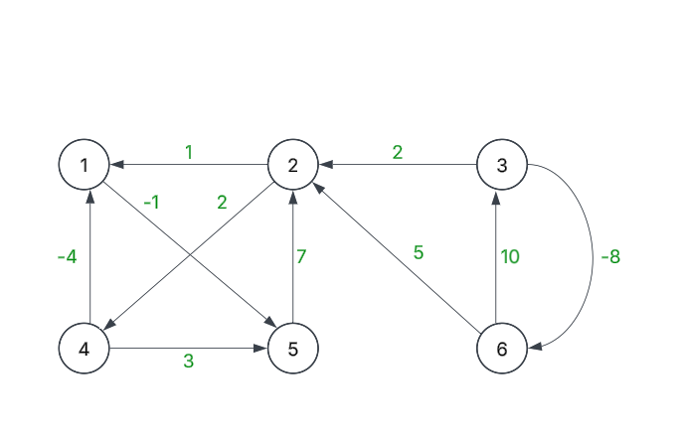
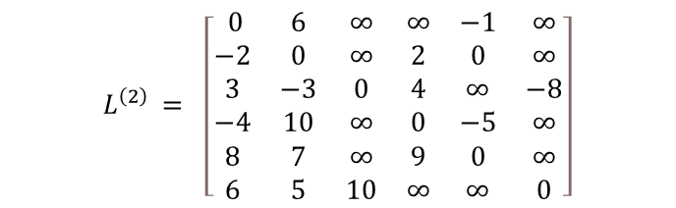

Example
Adjacent matrix:
$$L^{\left(1\right) }= \left[\begin{matrix}0 & ∞ & ∞ & ∞ & −1 & ∞ \\ 1 & 0 & ∞ & 2 & ∞ & ∞ \\ ∞ & 2 & 0 & ∞ & ∞ & −8 \\ −4 & ∞ & ∞ & 0 & 3 & ∞ \\ ∞ & 7 & ∞ & ∞ & 0 & ∞ \\ ∞ & 5 & 10 & ∞ & ∞ & 0\end{matrix}\right]$$
$$L^{\left(2\right) }= \left[\begin{matrix} 0 & 6 & ∞ & ∞ & −1 & ∞ \\ −2 & 0 & ∞ & 2 & 0 & ∞ \\ 3 & −3 & 0 & 4 & ∞ & −8 \\ −4 & 10 & ∞ & 0 & −5 & ∞ \\ 8 & 7 & ∞ & 9 & 0 & ∞ \\ 6 & 5 & 10 & ∞ & ∞ & 0\end{matrix}\right]$$

Slide 60


Example
$$L^{\left(3\right) }= \left[\begin{matrix} 0 & 6 & ∞ & 8 & −1 & ∞ \\ −2 & 0 & ∞ & 2 & −3 & ∞ \\ −2 & −3 & 0 & −1 & 2 & −8 \\ −4 & 2 & ∞ & 0 & −5 & ∞ \\ 5 & 7 & ∞ & 9 & 0 & ∞ \\ 3 & 5 & 10 & 7 & 5 & 0\end{matrix}\right]$$
$$L^{\left(4\right) }= \left[\begin{matrix}0 & 6 & ∞ & 8 & −1 & ∞ \\ −2 & 0 & ∞ & 2 & −3 & ∞ \\ −5 & −3 & 0 & −1 & −3 & −8 \\ −4 & 2 & ∞ & 0 & −5 & ∞ \\ 5 & 7 & ∞ & 9 & 0 & ∞ \\ 3 & 5 & 10 & 7 & 2 & 0\end{matrix}\right]$$

Slide 61


Example
$$L^{\left(5\right) }= \left[\begin{matrix} 0 & 6 & ∞ & 8 & −1 & ∞ \\ −2 & 0 & ∞ & 2 & −3 & ∞ \\ −5 & −3 & 0 & −1 & −6 & −8 \\ −4 & 2 & ∞ & 0 & −5 & ∞ \\ 5 & 7 & ∞ & 9 & 0 & ∞ \\ 3 & 5 & 10 & 7 & 2 & 0\end{matrix}\right]$$
$${L^{\left(5\right) }}_{i,j}=min⁡({L^{\left(4\right) }}_{i,k},{L^{\left(1\right) }}_{k,j})$$

Slide 62

Fast-All-Pairs-Shortest-Path
The fast algorithm is the same as the slow one, except that the matrices are computed for the powers of 2
i.e. $L^{(1) }$, $L^{(2) }$, $L^{(4) }$ , $L^{(8) }$…
For each matrix, ${L^{M}}_{i,j}=min⁡({L^{M−1}}_{i,j},{L^{M−1}}_{i,k}+{L^{M−1}}_{k,j})$
for all 𝑘 = 1 to 𝑛.

Slide 63
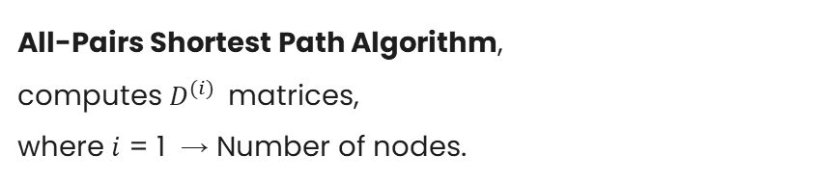
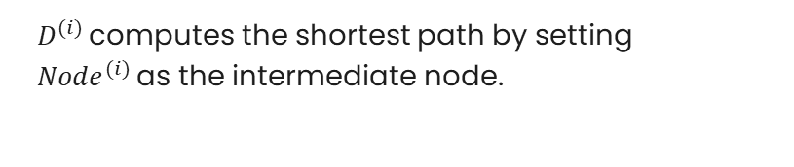
Floyd-Warshall
All-Pairs Shortest Path Algorithm,
computes $D^{(i) }$ matrices,
where $i$ = 1 → Number of nodes.
$D^{(i) }$computes the shortest path by setting
${Node}^{(i) }$as the intermediate node.

Slide 64
08
Flow Networks

Slide 65
Flow Networks
Ford-Fulkerson algorithm to compute the maximum flow between s and t

Slide 66
Flow Network’s Example
Iteration 1
8
8
a
d
f
10
2
7
s
5
t
9
c
9
3
3
12
11
b
e
g
1
6
Flow = 8

Slide 67
Flow Network’s Example
Using path s → a → d → f → g → t
8/8
8/8
a
d
f
8/10
2
7
s
5
t
9
c
8/9
3
3
12
8/11
b
e
g
1
6

Slide 68
Flow Network’s Example
Residual Network
8
8
8
a
d
f
2
2
7
8
s
5
1
t
9
c
3
3
3
12
8
b
e
g
1
6

Slide 69
Flow Network’s Example
Iteration 2
8
8
8
a
d
f
2
2
7
8
s
5
1
t
9
c
3
3
3
12
8
b
e
g
1
6

Slide 70
Flow Network’s Example
Using path s → b → c → e → g → t
8
8
8
a
d
f
2
2
7
8
s
5
1
t
9
c
3/3
3/3
3/3
3/12
8
b
e
g
1
3/6

Slide 71
Flow Network’s Example
Residual Network
8
8
8
a
d
f
2
2
7
8
s
5
1
t
9
c
9
3
3
11
3
b
e
3
g
1
3
Flow = 11

Slide 72
Flow Network’s Example
Iteration 3
8
8
8
a
d
f
2
2
7
8
s
5
1
t
9
c
9
3
3
11
3
b
e
3
g
1
3

Slide 73
Flow Network’s Example
Using path s → b → e → g → f → t
8
8
8
a
d
f
1/2
2
7
7
s
5
2
t
9
c
3
10
1/9
3
3
b
e
1/3
g
1/1
1/1
3

Slide 74
Flow Network’s Example
Residual Network
8
8
8
a
d
f
2
7
7
1
s
9
5
2
t
c
3
11
8
3
4
b
e
2
g
1
4
Flow = 12

Slide 75
Minimum Cut
A separator splits the graph to minimize the input from the source subgraph to the target one.

Slide 76
Minimum Cut’ Example
8
8
a
d
f
10
2
7
s
5
t
9
c
9
3
3
12
11
b
e
g
1
6
Min. Cut
12
19
9
13

